Slide 1



Time-Synchronized Measurements in Romania
Technology and Applications
Florin Bălaşiu, Anamaria Iamandi
Gregary C. Zweigle, Jared Bestebreur, Ciprian Hosu, Diego Rodas
Transelectrica, UNO DEN, Romania
Schweitzer Engineering Laboratories, U.S.A.

Slide 2

Content
Transelectrica – The Romanian Transmission System Operator
Overview of the Transmission Network
Synchrophasor System Architecture
Synchrophasor Applications
Future Developments

Slide 3
Transelectrica – The Romanian Transmission System Operator

Slide 4
Romanian Electricity History
1882, First Power Plant built in Bucharest
1884, Timisoara becomes first city in Europe with electric street lighting
1939, Country wide electricity generation
Notes:
1882 - The first power plant was commissioned in Bucharest. The plant provided the exterior lighting for the "National" Theatre and the "Cismigiu" Garden.The power plant was located in the "Calea Victoriei" road in the heart of Bucharest downtown.
During the same year, the first power transmission between the power plant and the Royal Palace Cotroceni was performed on a 3 km overhead electric line with cooper conductors and porcelain insulators.
All those projects were carried out the same year when Thomas Alva Edison commissioned the world's first power plant in New York.
1884 - Timisoara, one of the major cities of Romania situated in the Western side of Romania was the first city in Europe in which the electric street lighting was introduced.
The plant and the lighting installation were opened for a trial period between 15 and 30 November. Tests were conducted by experts from Austria and Hungary who concluded that the installation had been fully compliant.
Commissioned in November 1884, the Electric Power Plant of Timisoara laid the ground of the Romanian Power System.
1939 - By 1939 the production and usage of electricity was spread all around Romania. At the end of 1939 Romania had 229 electricity generators out of which:
- 113 private companies and concessions
- 85 municipal service companies
- 10 public commercial authorities
- 14 joint ventures
- 7 state owed authorities

Slide 5
Romanian Electricity History
1955, Setting up of the National Power Dispatch Center
1958, Development of the Romanian Power System
2000, Transelectrica is founded as Romanian TSO
Notes:
1955 - The National Power Dispatcher started its operation on June 13th, 1955, which had been initially set up under a MEE (Ministry of Electrical Energy) order as a 'National dispatch department' within the Electricity Division of MEE. The main function of the NPD was to coordinate the electricity generation, transmission and distribution within the interconnected National Power System, which included the region of Muntenia and the central-eastern part of Transylvania. The activity of the respective areas was coordinated from the immediately subordinated level- the dispatchers of the power trusts of Bucharest and Sibiu, as well as the power factories of Constanta, Galati, Bacau, Timisoara and IRE Oradea.
1958 - In 1958 the Romanian Power System was created through the interconnection of the local subsystems. The regional enterprises were created in 1948 when all electricity producers became state owned companies.
2000 - The National Power Grid Company - Transelectrica (joint stock state-owned company) was founded further to the Romanian Government Ordinance No. 627/2000, by splitting off the former vertically integrated National Electricity Company into separate legal entities:
SC TERMOELECTRICA SA for electricity and heat generation
SC HIDROELECTRICA SA for electricity generation
SC ELECTRICA SA for electricity distribution and supply
CN TRANSELECTRICA SA for electricity transmission, power system operation and dispatching

Slide 6
Transelectrica – Mission
Transelectrica’s mission is to ensure the Romanian Power System (RPS) reliable and stable operation at quality standards, while providing the national electricity transmission network under transparent, non-discriminatory and fair conditions to all market participants.

Slide 7
Overview of the Transmission Network

Slide 8
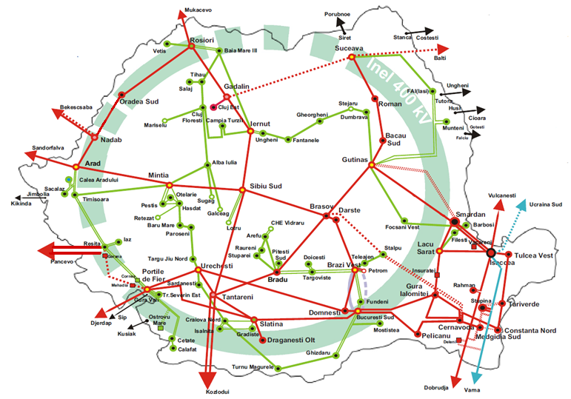
Legend:
Overview of the Romanian Transmission Network
400kV
220kV
400kV OHLs under construction
Notes:
In recent years a large amount of wind and solar energy resources have been added to the Romanian power system. Since 2009 a total of 3 GW wind and 1.5 GW solar has been added. Almost all wind generation is located in the south-east part, near the Black Sea and extension of the transmission network from this area is under construction. The two corridors, Cernavoda – Stalpu – Brazi Vest and Smardan – Gutinas are intended for existing wind power withdraw as well as creating conditions to further installation of wind capacities.
To achieve the challenge of 70% transfer capacity on cross border lines, put in place by EU 2019/943 Regulation, on the west side of the country an ongoing construction of 400 kV Over Head Lines will link at 400 kV Portile de Fier - Resita – Timisoara – Arad substations.

Slide 9
Overview of the Transmission Network
  81 substations 400/220 kV
  ~ 9000 km of transmission lines
  38058 MVA, total transformers capacity
Notes:
In recent years a large amount of wind and solar energy resources have been added to the Romanian power system. Since 2009 a total of 3 GW wind and 1.5 GW solar has been added. Almost all wind generation is located in the south-east part, near the Black Sea and extension of the transmission network from this area is under construction. The two corridors, Cernavoda – Stalpu – Brazi Vest and Smardan – Gutinas are intended for existing wind power withdraw as well as creating conditions to further installation of wind capacities.
To achieve the challenge of 70% transfer capacity on cross border lines, put in place by EU 2019/943 Regulation, on the west side of the country an ongoing construction of 400 kV Over Head Lines will link at 400 kV Portile de Fier - Resita – Timisoara – Arad substations.

Slide 10
Overview of the Transmission Network
  ~ 3.1 GW wind installed capacity
  ~ 1.4 GW solar installed capacity
  ~ 6 GW installed capacity in hydro power plants
  ~ 9.5 GW peak load
Notes:
In recent years a large amount of wind and solar energy resources have been added to the Romanian power system. Since 2009 a total of 3 GW wind and 1.5 GW solar has been added. Almost all wind generation is located in the south-east part, near the Black Sea and extension of the transmission network from this area is under construction. The two corridors, Cernavoda – Stalpu – Brazi Vest and Smardan – Gutinas are intended for existing wind power withdraw as well as creating conditions to further installation of wind capacities.
To achieve the challenge of 70% transfer capacity on cross border lines, put in place by EU 2019/943 Regulation, on the west side of the country an ongoing construction of 400 kV Over Head Lines will link at 400 kV Portile de Fier - Resita – Timisoara – Arad substations.

Slide 11
Generation/Load Distribution
  ~ 2.8 GW wind installed capacity, plus 1.4 GW in nuclear in Southeastern Area
  ~ 1,4 GW installed in the hydropower plant on Danube river and ~ 2,3 GW coal-based power plants located in the Southwestern Area
  Clear demarcation between south and north in generation capabilities
G2
G1

Slide 12
Load Distribution
  ~ 1.4 GW peak Load in Bucharest region
  ~ 2.8 GW peak Load in North Western region
  ~ 1.2 GW peak Load in North Eastern region
  of ~ 9.5 GW total peak load
L2
L3
G2
G1
L1

Slide 13
New Transmission Lines
L4
  The 400 kV Cernavoda – Gura Ialomitei – Stalpu – Teleajen - Brazi Vest and Smardan - Gutinas
  The 400 kV corridor Portile de Fier – Resita – Timisoara – Arad
  400 kV OHL Suceava - Gadalin
L2
L1+L3

Slide 14
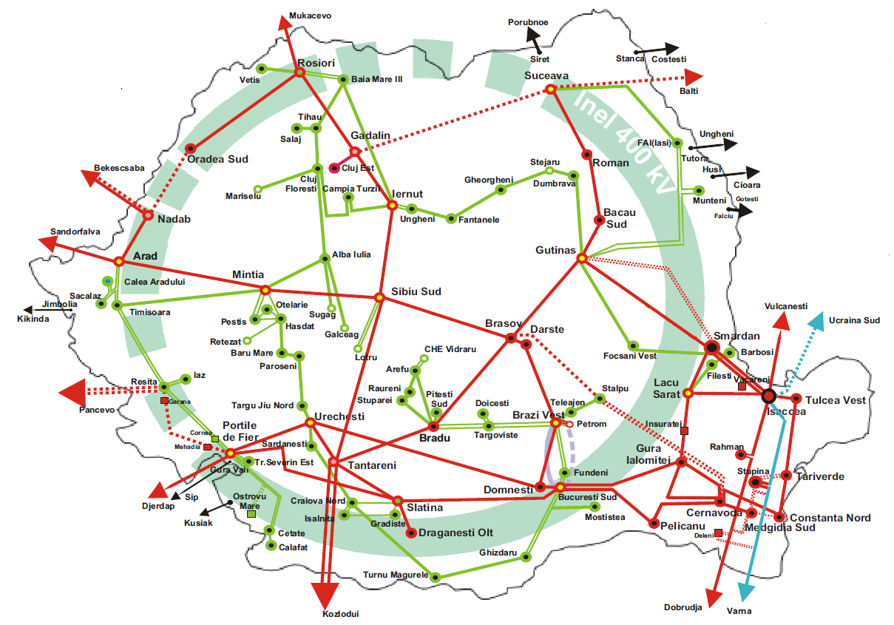

Modernization of Protection and Control
  20 substations under complete rehabilitation – primary and secondary equipment
  2 substations upgrading the protection and control systems
  One pilot project for a digital substation

Slide 15
Installing modern FACTS
  Control of the reactive power flow and voltage level control
  projects to install two STATCOM devices
  3 future projects for FACTS

Slide 16
Synchrophasor System Architecture

Slide 17
Synchrophasor Measurement System Evolution
2009, Stage 1 - Installation and Commissioning of a Synchrophasors Based System
2012, Stage 2 - Extension of the Existing System with Enhancing the Functionalities to Detect Inter-Area Oscillations
20XX, Stage 3 - Future Extensions of the System with the Modernization of Existing Power Substations and Integration of Renewable Generation

Slide 18
Stage 1 – Substations Level
Synchrophasors Cabinets Installed in 12 Carefully Selected 400kV Substations
PMUs Stream Data (25msg/s) to a Central PDC via Existing TDM System
Notes:
For the first point it will be good to identify the reasons why the selection was made: Important Generation points, Interconnection Lines, Important Loads, to monitor Weak Links in the system etc.

Slide 19
Stage 1 – Control Center Level PDC
Central PDC Located to National Dispatch Centre
Central PDC Configured with 6 Output Streams
Central PDC Archive all the Data Locally

Slide 20
Stage 1 – Control Center Level Visualization
Used for Monitoring and Archiving
  Phasors Scope to Monitor Angle Stability
  Timeline to Monitor Voltage and Frequency Stability
  Timeline to Power Flow

Slide 21
Stage 2 - Overview
Additional Substations are Covered
Local PDCs are Installed
Inter-area Oscillation Detection for Interconnection Lines Introduced

Slide 22
Stage 2 – Control Center Level PDC and SVP
1 New Central PDC
2 x SVPs
Newer Generation Visualization Software
Notes:
1 x New Software based PDC is installed to cater for the extension of the system and provide future proof expandability for it.
2 x Synchrophasors Vector Processors are installed to detect inter-area oscillation based on Modal Analysis algorithms. The signals monitored is the power transfer over the interconnection lines. Four modes are enabled for each interconnection line.
Newer generation software was installed to cater

Slide 23
Stage 2 – Control Center Level Visualization
  The new software tools include:
  Geographical Map with Real Time Identification of Weak Spots
  Custom Alarms and Warnings
  Disturbance Detector with Identification of Affected Assets
  Integration of High Waveform Events up to 8KHz
  Capabilities to Export Data in COMTRADE or CSV format
Notes:
Configured Custom Alarms to alert the operators and engineers to changing conditions, and help them determine appropriate control actions.
Exported data are used to run post event analysis and share them with the ENTSO community to analysis region wide events.

Slide 24
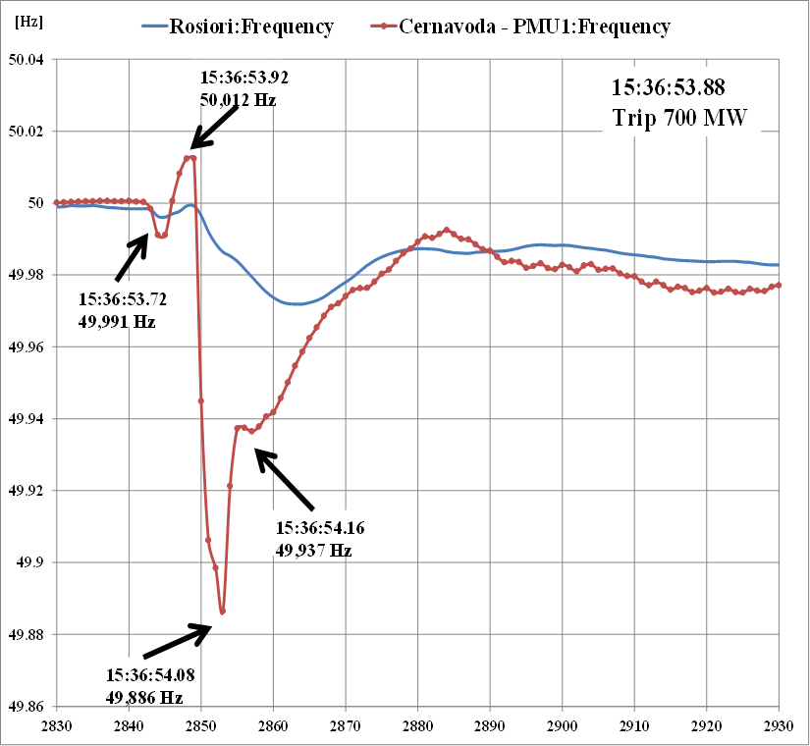
Post Event Analysis – November 2016
Along with real-time monitoring another useful feature is the post event disturbance analysis
Different analysis are used to investigate:
  Dynamic behavior of generating units
  Frequency deviation and RoCoF
  Damping of oscillations on the 400 kV busbars
  Phase-angle deviation in between substations
  Cross-border power flows

Slide 25
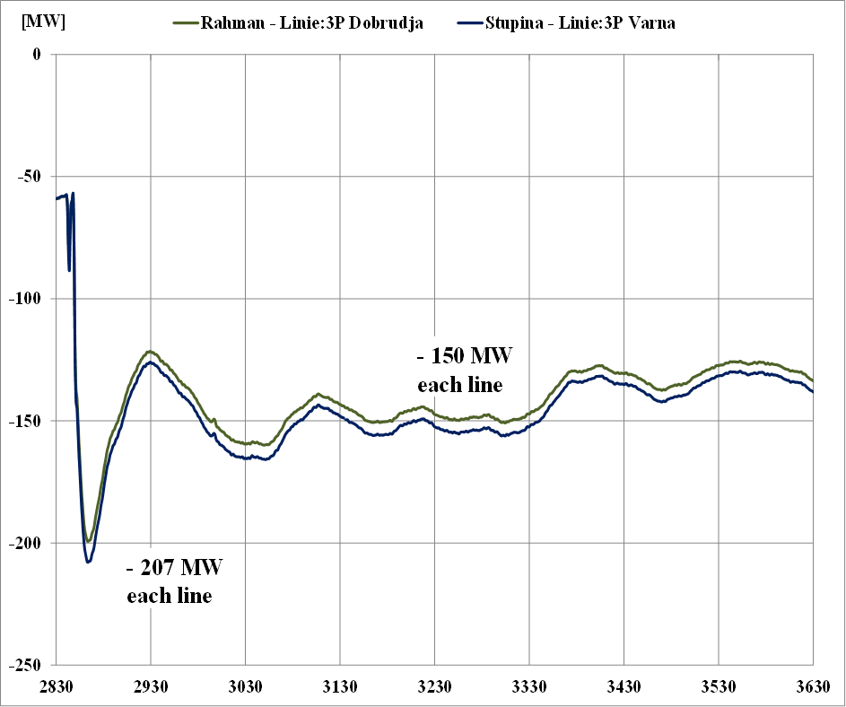
Post Event Analysis – November 2016
In the first moments, the lose of active power was compensated by the cross-border interconnections. For example, the diagram shows that from Bulgaria about 400 MW were injected in the power system. After, about 300s frequency and cross border flows were reestablished totally due to local reserve utilization.

Slide 26
Stage 3 - Ongoing
Every 400 kV Modernized Substation Includes a Synchrophasor Cabinet
Islanding Detection of DG with a Load Connected on Loss of Connection to the Common Connection Point
To integrate Low Inertia Generation Sources the important Requirement is to provide Synchrophasor Measurement Devices
Notes:
Cabinets are similar in design as per Stage 2.
An SVP was used to implemented Islanding Detection of DG where there was a possibility that the connection to the Bulk Power System would create an island and the traditional under/over voltage and under/over frequency protection won’t operate due to Power Generated being equal with the Power Consumed in the island. The busbar angles difference of the positive sequence voltage measured at PCC and DG substations was used as main detection algorithm.

Slide 27
The Future of Time-Synchronized Systems

Slide 28
Future of Time-Domain Data
SCADA and synchrophasors
rely on same quasi-steady-state, lossy phasor approximation
Wide-area time-domain data
makes all information available enables new benefits and innovations
Dynamics
Forced oscillation detection
SSR
Detailed system events
Model validation
GMD
Harmonics
Equipment failure prediction
f₀
Frequency
Notes:
Both SCADA and Synchrophasor measurement devices end up filtering out information that is ultimately of interest to utility engineers. We see a future where time-domain data (point-on-wave) is streamed from select locations at thousands of messages per second to address specific application concerns. The Synchrowave Platform was designed from the beginning to support streaming data at these rates.

Slide 29
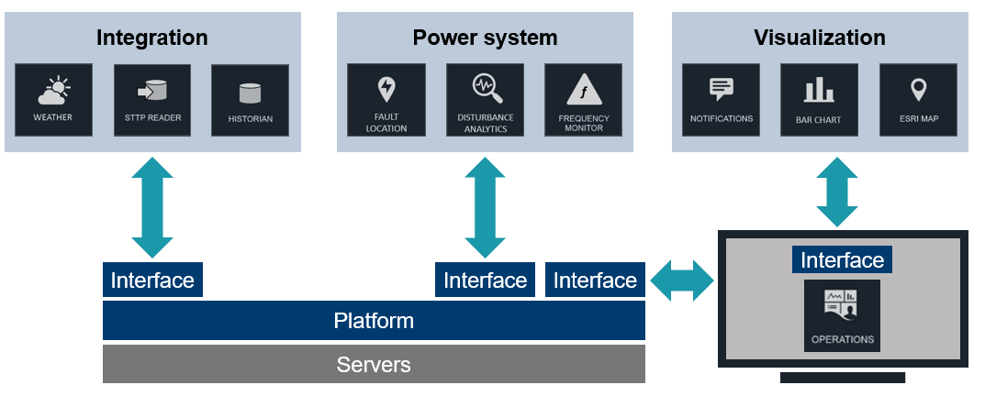
Open Applications Platform
Notes:
Interoperability is becoming more important because of the need to link many data types to synchrophasors. These data include information about weather, fire, lightning, relays, and geographical mapping. The software and associated database are designed not only for synchrophasors, but generally for all time-stamped data types.

Slide 30
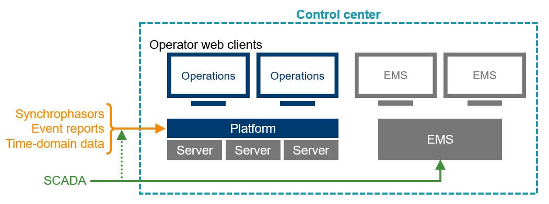
Time-synchronized Software Connections to SCADA System and EMS
Time-Series Platform
Notes:
Interoperability is also important between software programs from multiple suppliers. Fig. 7 shows the new software approach that connects information in an energy management system (EMS). These connections among different systems enable alarm coordination. The high-resolution time-series data and associated analytics allow better and more accurate system assessments and provide this information to the EMS to reduce unwanted or unclear alarms from populating the operator screens. The connection between systems also provides a path for model information, which is then displayed on the synchrophasor software screens to improve how engineers and operators interface with the data

Slide 31
Thank you!

