Slide 1
Scalable WAMPAC product SIGUARD PDP and its application in system stability observation and protection
  IEEE 2021 International Conference on Smart Grid Synchronized Measurements and Analytics – SGSMA 2021, May 25th - 27th 2021
  Gold Sponsorship 3 presentation on May 27th, 1:30 pm - 2:15 pm, CEST (+2.00 UCT)
  Dr. Andreas Litzinger, José Malagon, Siemens AG, Germany

Slide 2
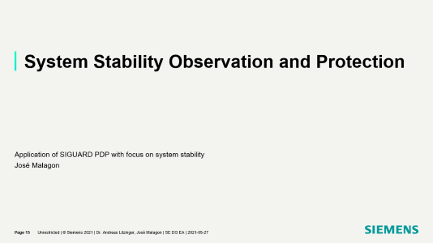
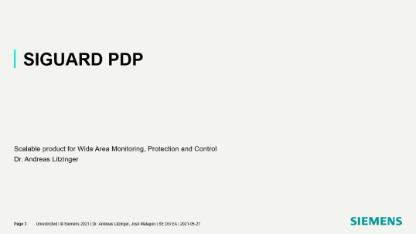

Slide 3
SIGUARD PDP
    Scalable product for Wide Area Monitoring, Protection and Control
    Dr. Andreas Litzinger

Slide 4
SIGUARD PDP
Highlights
SIGUARD PDP
is a
scalable,
fully integrated,
worldwide used
solution for
Wide Area Monitoring, Protection and Control (WAMPAC)

Slide 5
SIGUARD PDP
Highlights
Scalable
    Small substation data concentrator, small number of PMU (~ 10)
    Regional data concentrator, mid number of PMU (~ 50)
    Regional monitoring system with applications, with or without redundancy
    National monitoring system with applications, single site, high number of PMU (~ 250), with or without redundancy
    National monitoring system with applications, with data maintenance, main, backup and development site (multisite), bulk number of PMU (> 600), mixed redundant and non-redundant sites
    Wide Area Protection with redundancy
    All these projects use same software package. Software license structure is designed to allow pricing according to functions used.
    Pay what you need

Slide 6
SIGUARD PDP
Highlights
Scalable
    Easy start into Wide Area Monitoring with simple data concentrator with integrated MMI
    Extension of existing system just needs additional software license, no additional installation or integration effort necessary
    Grows with your requirements
    Easy-to-use workflow to reduce upgrade costs for new functionalities provided with new versions
    Supports evergreen concept

Slide 7
SIGUARD PDP
Components
Fully integrated
    All functions needed for all use cases are integrated in SIGUARD PDP:
        Phasor data concentrator
        Integrated online archive solution supporting fast time series data handling
        Support for offline archive for cost-efficient long term storage and backup on LTO tapes
        User Interface
          Designed for both real-time observation and archive based analysis use cases
          Power System Status curve to get aware on system state at first glance
          Geographic representation of power system with visual alarming, application result visualization, and voltage contour
          Flexible Chart Areas for detailed analysis of time series and phasor data
          Filterable Alarm Lists and Event Lists
          Application specific representations (e.g. Power Swing Overview)
          User defined layout for different use cases, save and recall as Favorite
          Multi-monitor support by freely positionable modules

Slide 8
SIGUARD PDP
Components
Fully integrated
    All functions needed for all use cases are integrated in SIGUARD PDP:
        Protocol conversion for integration into other IT systems:
          Forwarding of PMU data to other PDC (IEEE C37.118)
          Forwarding essential information to SCADA/EMS/DMS (IEC 60870-5-104, ICCP Tase.2)
          Forwarding to automation systems (OPC DA)
          Alarming of administrators or expert users via email (SNMP)
        Applications:
          Island State Detection based on power frequency
          Power Swing Recognition based on active power of voltage phase angle difference
          Short Circuit Detection based on typical patterns of voltage and current
          Generation or Demand Loss detection based on typical pattern of power frequency
          Voltage Stability Curves, P-V-Diagrams

Slide 9
SIGUARD PDP
Components
Fully integrated
    All functions needed for all use cases are integrated in SIGUARD PDP:
        Engineer: integrated configuration tool for PMU, calculation, limit violation, graphic, application and communication
        Multisite manager to distribute tested configuration changes from data maintenance site to productive sites (main, backup, development system), redundant or non-redundant
    Only one or two servers needed, no additional application servers, no additional database servers, eases system commissioning and maintenance. Virtualization supported.
    UI workstations and/or UI server with e.g. remote desktop connection supported.

Slide 10
SIGUARD PDP
Experience
Worldwide used
    Substation data concentrators (Asia, Arabic peninsula)
    Non-Redundant WAMS (Europe, South America, Asia, Africa, Arabic peninsula)
    Redundant WAMS (South America, Asia)
    Multisite WAMS (Mid America)
    WAPS (South America, Europe)
SIGUARD PDP is on the world market for over 10 years, with more than 10 versions, continuously growing in functionality.

Slide 11
SIGUARD PDP
Use cases
All use cases are supported by SIGUARD PDP product.
Component | Use case | Substation Data Concentrator | Regional Data Concentrator | WAMS w/o Applications | WAMS with Applications | WAMS w/o Applications, redundant | WAMS with Applications, redundant | Multisite WAMS w/o Applications | Multisite WAMS with applications
Architecture |  | all-in-one | server/clients | server/clients | server/clients | 2x server / clients | 2x server / clients | N x (2x server / clients) | N x (2x server / clients)
PMU protocol |  | x | x | x | x | x | x | x | x
Collector |  | x | x | x | x | x | x | x | x
Calculation engine |  | x | x | x | x | x | x | x | x
Online archive |  | (x) | (x) | x | x | x | x | x | x
Offline archive |  |  |  | x | x | x | x | x | x
User Interface |  | x (1) | x (1) | x (N) | x (N) | x (N) | x (N) | x (N) | x (N)
Application | Island State Detection |  |  |  | x |  | x |  | x
 | Power Swing Recognition |  |  |  | x |  | x |  | x
 | Short circuit detection |  |  |  | x |  | x |  | x
 | Generation and demand loss |  |  |  | x |  | x |  | x
Interfaces | IEEE C37.118 | x | x | x | x | x | x | x | x
 | IEC 60780-5-104 |  |  | x | x | x | x | x | x
 | ICCP Tase.2 |  |  | x | x | x | x | x | x
 | OPC - DA | x | x | x | x | x | x | x | x
 | SNMP | x | x | x | x | x | x | x | x
Multisite Manager |  |  |  |  |  |  |  | x | x
Product |  | SIGUARD PDP | SIGUARD PDP | SIGUARD PDP | SIGUARD PDP | SIGUARD PDP | SIGUARD PDP | SIGUARD PDP | SIGUARD PDP

Slide 12
SIGUARD PDP
Oscillation monitoring application
Power Swing Recognition application (oscillation monitoring)
    Normal (0.05 Hz – 5 Hz) or extended frequency range (0.015 – 30 Hz, upper limit depending on PMU reporting rate)
    Active power, voltage phase angle difference and power frequency as input values
    Individual configurable jobs for each PMU location
    Combination of job results into global mode view
    Output results:
        Mode frequency
        Magnitude
        Damping
        Criticality (based on magnitude and damping) with consistent coloring in UI
        Mode shape (for active power)
        Coherence (end points of oscillations)
    Study mode for configuration optimization based on already recorded events
    All results stored in SIGUARD PDP archive for later analysis

Slide 13
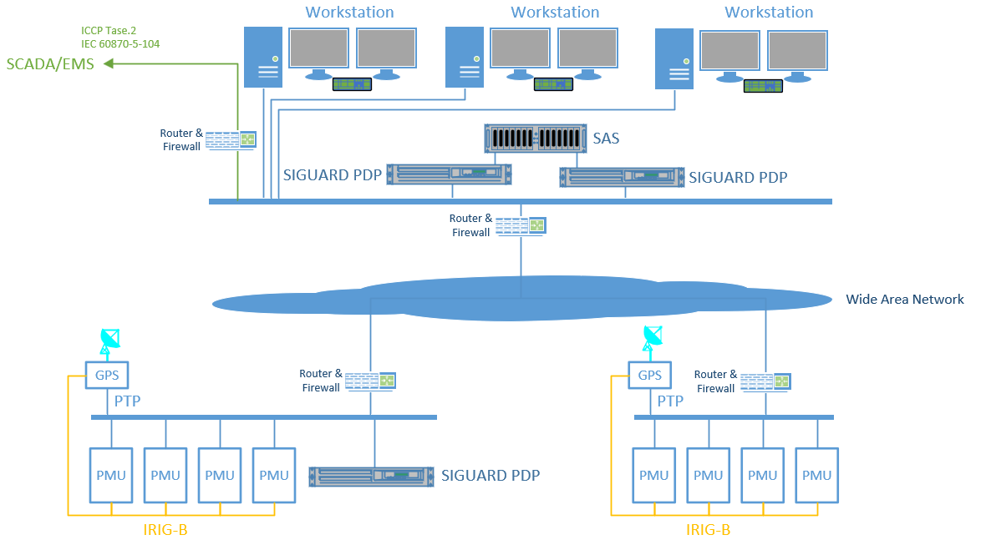
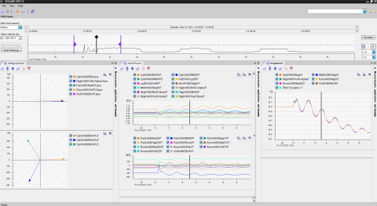
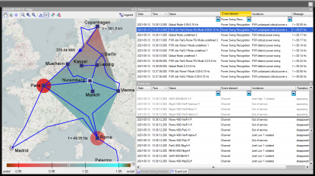
SIGUARD PDP
Architecture examples
SIGUARD PDP
at control center level
at substation level

Slide 14
SIGUARD PDP
Architecture examples
Multisite
Central data maintenance
Distribution of tested configuration to Main, Backup and Development
Support for different architecture at each site (redundant / non-redundant, flexible archive size)

Slide 15
System Stability Observation and Protection
    Application of SIGUARD PDP with focus on system stability
    José Malagon

Slide 16
SIGUARDTM PDP WAP
Why do we measure phasors? Stability Problems
Stability problem
Transient Stability
PRE-EVENT
Stability limit
POST-EVENT
Thermal
limit
Stability limit
Voltage Stability
Small Signal Stability

Slide 17
What Actions are Possible?
Preventive N-1 Operation → state of the art
State of the art: Operation Philosophy
Change of schedule
Re-dispatch
PRE-EVENT
Stability limit
POST-EVENT
Preventive change of system state
Thermal
limit
Stability limit

Slide 18
What Actions are Possible?
Change of limits where possible
ONLY if Stability is not in danger
Dynamic line rating
Adaptive Protection
Stability limit
PRE-EVENT
POST-EVENT
Change of limits (e.g. thermal line monitoring,…)
Thermal
limit
Stability limit

Slide 19
What Actions are possible?
Corrective actions (slow)
Corrective actions only if stability is not in danger
Load shedding
Adaptive protection
Adaptive load shedding
Adaptive generation shedding
HVDC setpoint changes
Topology changes
Stability limit
PRE-EVENT
Corrective change of system state (WAMPAC)
POST-EVENT
Thermal
limit
Stability limit

Slide 20
What Actions are possible?
Corrective actions (fast)
Fast Corrective actions if stability problem expected
Fix Special Protection Schemes SPS
FACTS
Adaptive SPS (Parameter)
SPS with communication and central coordination
HVDC control
PRE-EVENT
Stability limit
POST-EVENT
Fast Response
WAMPAC
CONTINGENCY 2
FAULT IN THE LINE
Thermal
limit
Stability limit

Slide 21
WIDE AREA PROTECTION SYSTEMS (WAP) WHEN? WHY?
WIDE AREA MONITORING PROTECTION AND CONTROL
WAMPAC PMU BASED
 | PMU BASED
Voltage / Current | magnitude and phase
Frequency | yes
Reporting rate | up to 100/120 per s
Simple commands | 60870-5-104
Protocol | IEEE C37.118
Time synchronization | strong (GPS), 5µs accuracy IRIG-B or IEEE1588
WIDE AREA CONTROL WAC
WIDE AREA PROTECTION WAP
Change of Control Schemes
HVDC
FACTS
Phase Shifting Transformers
Tap Changers
Switching Actions
Set points for Fast Devices (HVDC)
PROTECTION
OPERATION
APPROX 80 ms.
TRIP
PREFAULT
To
80ms
Tcascading
 | RTU
Voltage / Current | magnitude only
Frequency | no
Reporting rate | 1 per 5…10 s
Simple commands | yes
Protocol | several
Time synchronization | 1 ms
Not PMU based actions
Redispatch
Outage Scheduling
N-1 Criterium
Special Protection Schemes
Fixed or hardwired
Local load shedding
Operational tripping schemes
Armed and disarmed from SCADA
Notes:
An SPS does not include (a) underfrequency or undervoltage load shedding or (b) fault conditions that must be isolated or (c) out-of-steping relaying (not designed as an integral part of an SPS). Also called Remedial Action Scheme.

Slide 22
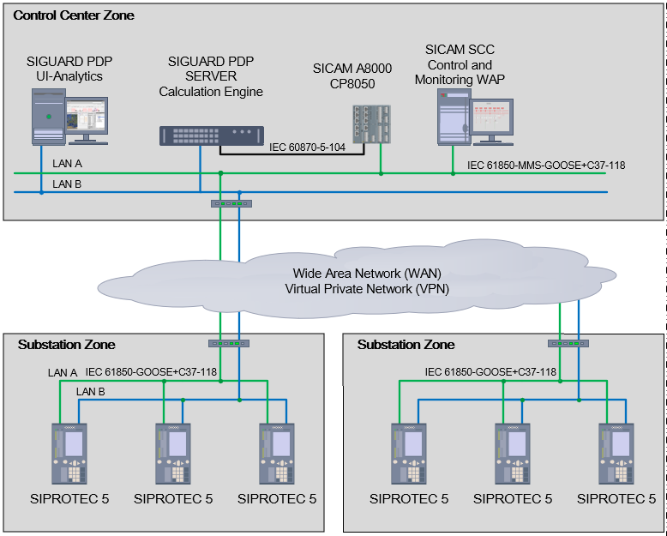

SIGUARD PDP
Wide area PROTECTION system
Identify power system contingencies based on customized calculations
Analyze and evaluate with intuitive user interface
From remedial action schemes to Wide Area Protection Systems in one step
Commands from SICAM A8000 to PMU´s via IEC 61850 GOOSE
Control and visualization of the system with SICAM SCC
Transfer of PMU data via C37.118 to the PDC
Simple configuration of the SIPROTEC 5 PMUs with DIGSI 5
SIPROTEC 5 PMU and SIGUARD PDP are the building blocks, providing all the required functions to creating a smart Wide Area Protection system

Slide 23
SIGUARD PDP WAMPAC
Components
1. Phasor measurement units PMUs
2. Phasor Data Procesor Siguard PDP + CP8050
3. Wide Area Network WAN
4. C37.118 - IEC 61850 Goose Standard Protocols
5. Wide Area Network

Slide 24
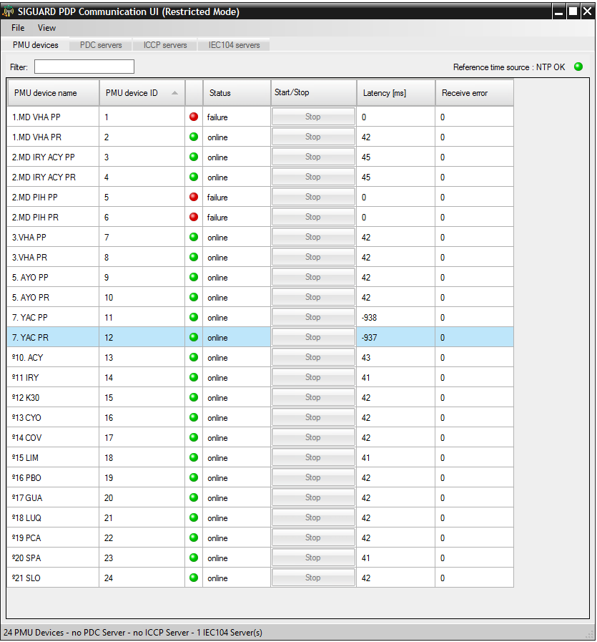
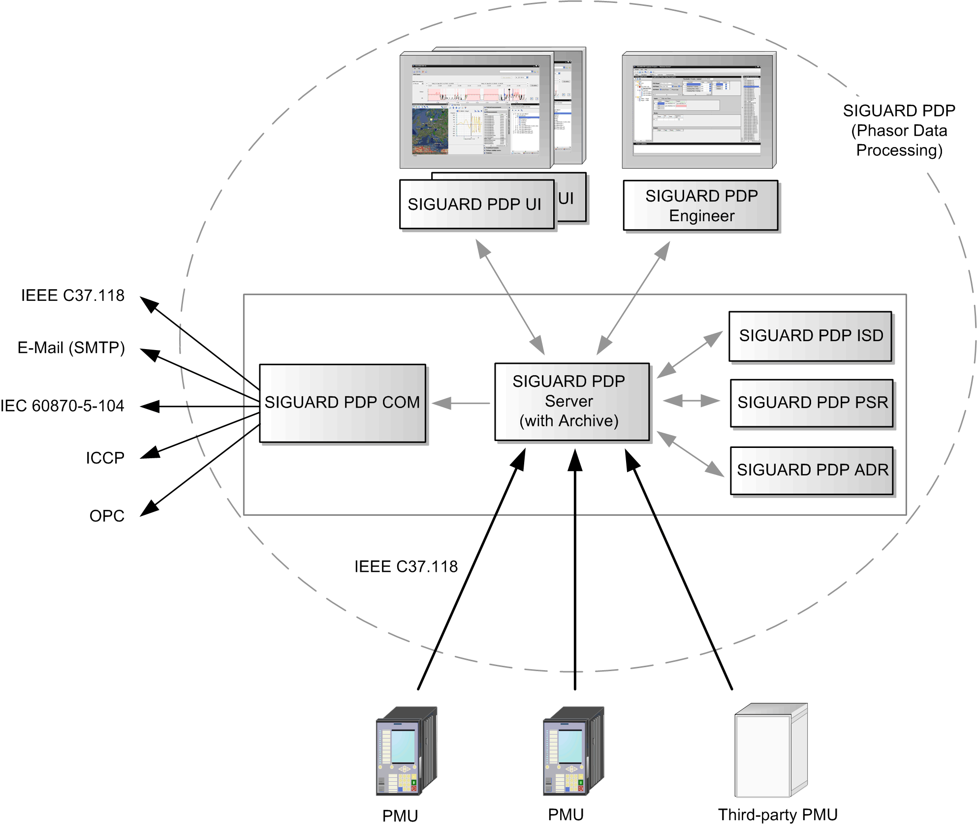
SIGUARD PDP
Components

Slide 25
SIGUARD PDP
Components
  SIGUARD PDP UI (User Interface)
  This component is the SIGUARD PDP user interface. Designed to display and analyze the information both in online mode (real time) and offline mode (data from archive). Can be installed on separate user workstations, TCP/IP communication to server.
  SIGUARD PDP Engineer
  This component is the SIGUARD PDP configuration tool. Installed with user interface on separate user workstations.

Slide 26
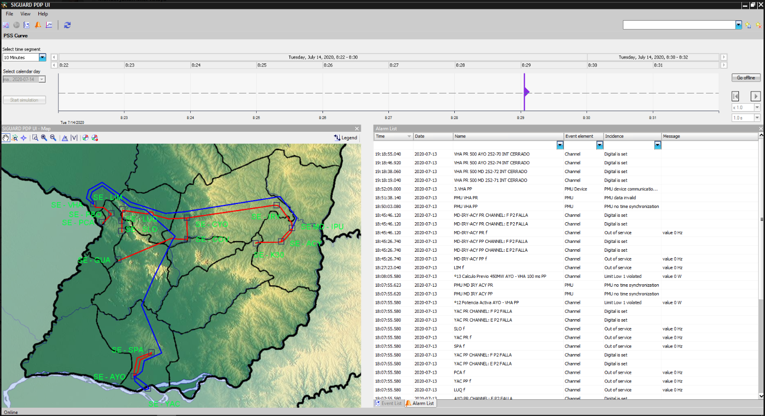
SIGUARD PDP
Components

Slide 27
SIGUARD PDP
Calculations for WAP
Angle difference between two phasors with limit, using absolute value and pickup timer.
  Inputs:
    Two voltage phasors, positive sequence preferred
    Threshold value in degree
    Pickup time in seconds
  Output: digital signal, set to 1 if limit is violated for longer than pickup time
  Comparator
  Inputs:
    Two analog signals pos (+) and neg (-), either measurement or constant
  Output: digital signal, set to 1 if pos > neg.

Slide 28
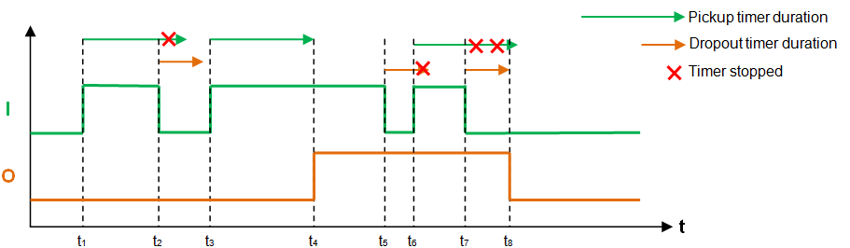
SIGUARD PDP
Calculations for WAP
  Rising edge detects a rising edge and sets the output to 1 for one cycle. Falling edge detector can be build by using NOT calculation. Input and output signals are digital signals.
  Flip flop with dominant reset signal. Input and output signals are digital signals. Output is set to 0 if RST has rising edge. Output is set to 1 if SET has a rising edge.
  Timer with pickup time and dropout time
  O is set to 1 if I is 1 for longer than pickup time
  O is set to 0 if I is 1 for longer than dropout time
  Pickup time and dropout time can be set to 0.

Slide 29
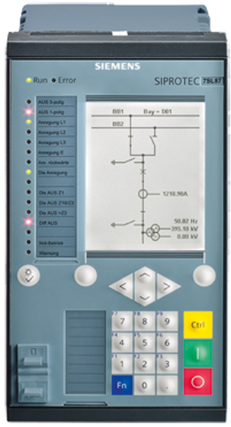


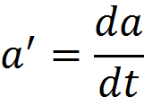
SIGUARD PDP
Calculations for WAP
  PMU status to digital, digital output is set to 1 if quality of PMU is good (data was received, but no PMU Error, no PMU data invalid, no PMU time sync error, no Out of service)
  Delayer to allow closing of loops. Available for phasors, analogs and digitals.
  Logical AND / OR with more than two inputs, inversion possible
  Absolute value of phasor (= magnitude) or analog
  Rate of change of analog value

Slide 30
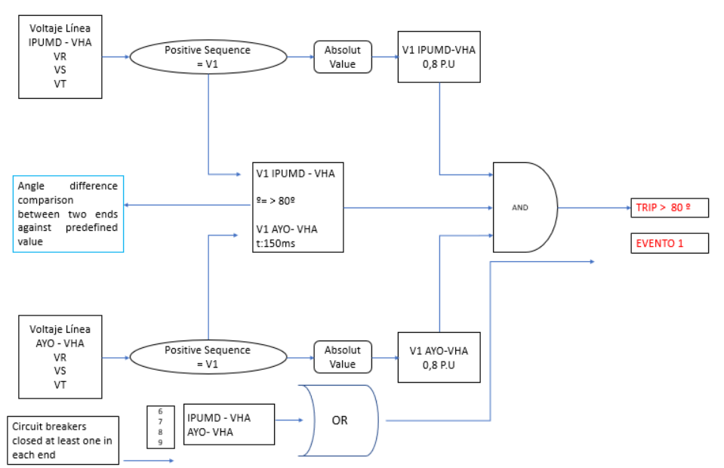
SIGUARD PDP
Calculation example of the WAP logic implemented

Slide 31
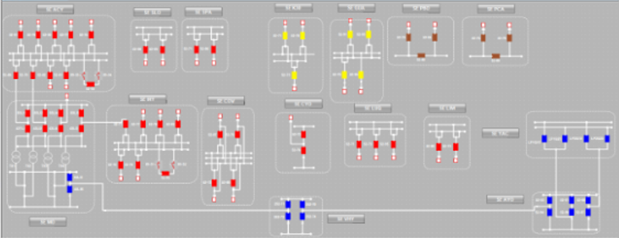
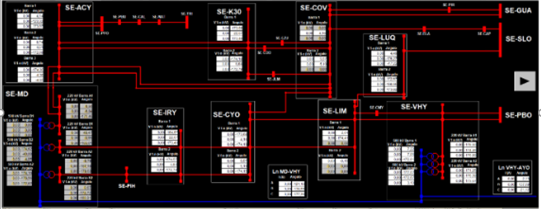
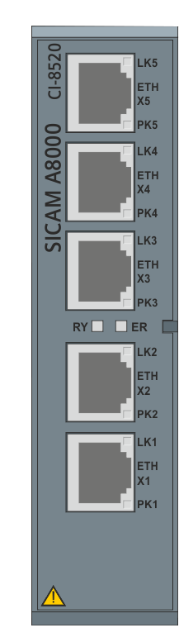
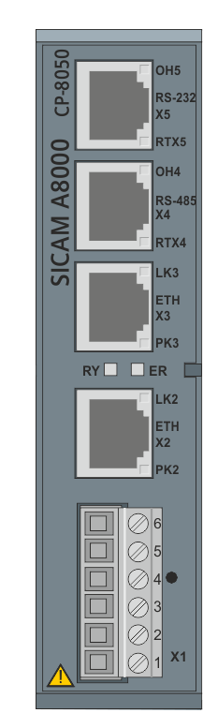
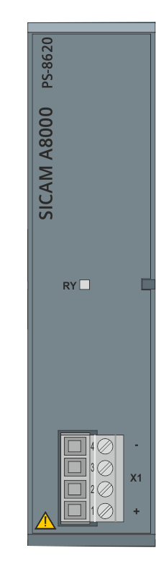
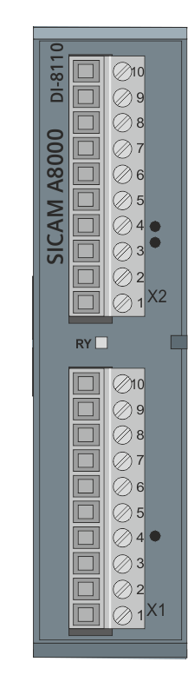
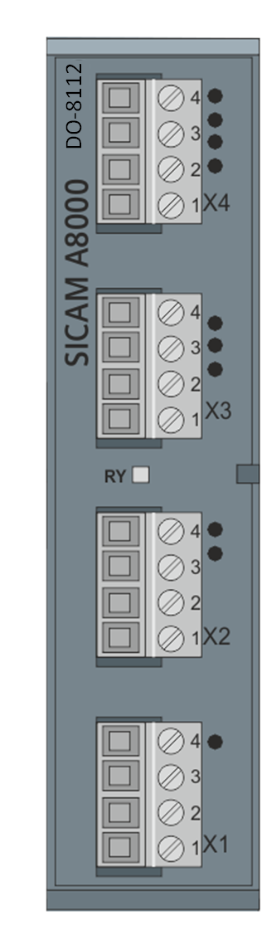
WAP
SICAM A8000 and SICAM SCC
SICAM A8000 CP-8050
Expandable Ethernet communication module (CI-8520 module)
Protocol IEC 60870-5-104
IEC 61850 and GOOSE
PRP redundancy
Protocol conversion form IEC 60870-5-104 to 61850 and Goose
Sicam SCC to visualize actual state of the stations involved in WAP and to enable and disable the WAP schemes

Slide 32
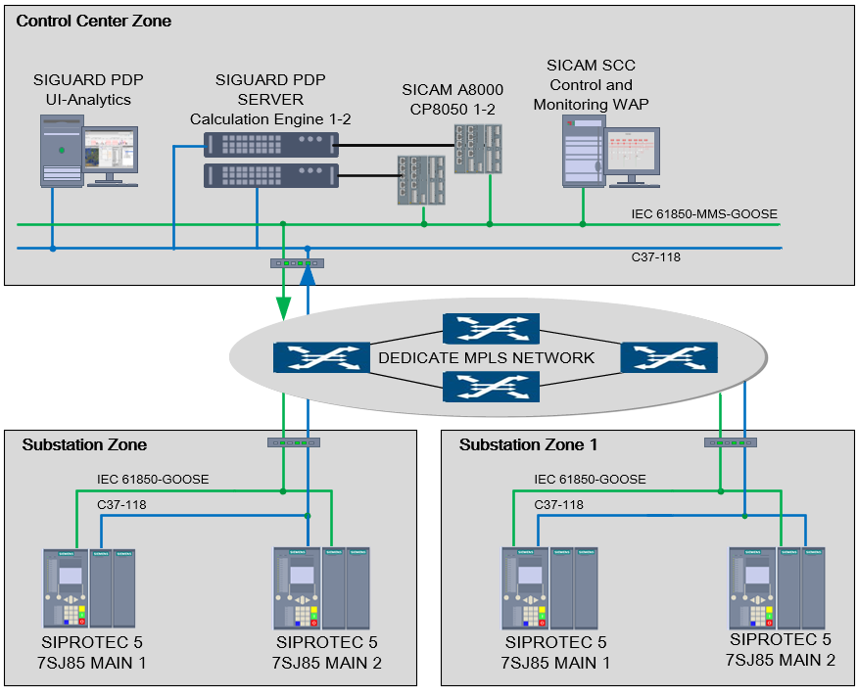
Wide Area protection with redundancy
Double calculation engine to grant the redundancy with SIGAURD PDP
Double PMU in station level to collect the measurements with SIPROTEC 7SJ85 and to generate the trip command
MPLS Network to transmit the GOOSE command to achieve tripping times less than 200 ms over the WAN
SICAM SCC to control and monitor the Wide Area Protection system
Notes:
A redundant phasor data procesor Siguard PDP in configuration of Main 1 and Main 2 to calculate the angle diference and able to do additional calcluation to calculate the active power
Redundant PMU Siprotec 5 7SJ85 in the station level to collect the measurements and to send trip command to the Circut breaakers
MPLS Network to trasmit the GOOSE command to achieve tripping times less than 200 ms over the WAN, a wide area network with lengths up to 500 km
SICAM SCC to control and monitor the Wide Area Protection system

Slide 33
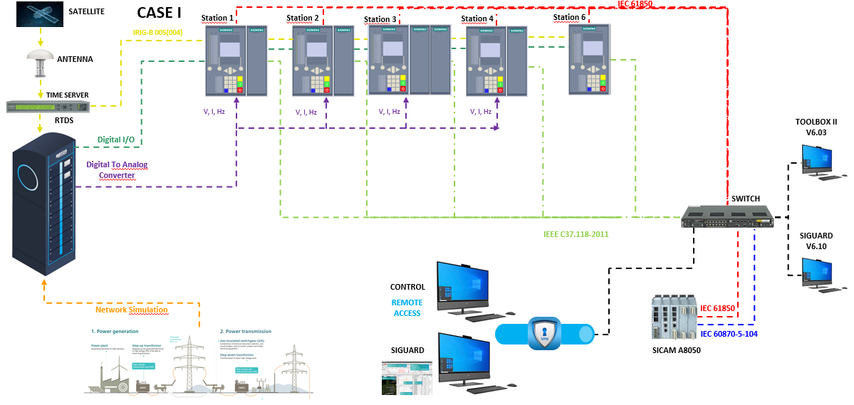
System Test
Notes:
The system was extensively tested in different stages. The first tests were carried out during the manufacture of the panels where the interfaces between the different components, protocols and logics implemented in the system were tested.
The solution was extensively tested in a real time digital simulator (RTDS) with different system contingencies where the operation of the WAP system was confirmed for the different events of the power system.
3. On site tests were carried out again and a real event was created to contrast the operation of the scheme.
4. The operation of the schemes was confirmed with times less than 200 ms. The scheme has been operating successfully since February,

Slide 34
Disclaimer
© Siemens 2021
Subject to changes and errors. The information given in this document only contains general descriptions and/or performance features which may not always specifically reflect those described, or which may undergo modification in the course of further development of the products. The requested performance features are binding only when they are expressly agreed upon in the concluded contract.
All product designations may be trademarks or other rights of
Siemens AG, its affiliated companies or other companies whose use by third parties for their own purposes could violate the rights of the respective owner.

Slide 35
Contact
Published by Siemens AG
  Dr. Andreas Litzinger
Senior Key Expert “Wide Area and Grid Measurements”
Product Owner SIGUARD PDP
SI DG EA-P&R DE-HP
Humboldtstr. 59
90765 Nürnberg
Germany
  Mobile +49 172 826 8876
  E-mail andreas.Litzinger@siemens.com
  José Malagon
Promotor “Wide Area Monitoring, Protection and Control”
SI DG EA-P&R DE-HP
Humboldtstr. 59
90765 Nürnberg
Germany
  Mobile +49 (172) 1534595
  E-mail jose.malagon@siemens.com

